Slide 1
Dynamic Modeling
Lecture # 37

Slide 2
Dynamic Modeling
Temporal relationships are difficult to understand
A system can first be understood by examining its static structure and the relationships that exist among different elements at single moment in time

Slide 3
Dynamic Modeling
Then we examine changes in these elements and their relationships over time
Those aspects of a system that are concerned with time and changes are the dynamic model

Slide 4
Dynamic Modeling
Control is an aspect of a system that describes the sequences of operations that occur in response to external stimuli, without consideration of what the operations do, what they operate on, or how they are implemented

Slide 5
Dynamic Modeling
Dynamic modeling deals with flow of control, interactions, and sequencing of operations in a system of concurrently-active objects
Major dynamic modeling concepts are events, which represent external stimuli, and states, which represent values of objects

Slide 6
Dynamic Modeling
There are two ways to model dynamic behavior
One is the life history of one object as it interacts with the rest of the world; the other is the communication patterns of a set of connected objects as they interact to implement behavior

Slide 7
Dynamic Modeling
The view of an object in isolation is a state machine – a view of an object as it responds to events based on its current state, performs actions as part of its response, and transitions to a new state
This is displayed in state chart diagrams in UML

Slide 8
Dynamic Modeling
The view of a system of interacting objects is a collaboration, a context-dependent view of objects and their links to each other, together with the flow of messages between objects across data links
Collaboration and sequence diagrams are used for this view in UML

Slide 9
Techniques for Dynamic Modeling
Finite state machines (FSM)
Statecharts
Petri nets
Decision tables and decision trees
Collaboration diagrams
Sequence diagams

Slide 10
Finite State Machines
A finite state machine (FSM) is a hypothetical machine that can be in only one of a given number of states at any specific time
In response to an input, the machine generates an output and changes state

Slide 11
Finite State Machines
Both the output (O) and the next state (S_{N}) are purely functions of the current state (S_{C}) and the input (I)
  S_{N} = F(S_{C}, I)
  O = G(S_{C}, I)

Slide 12
Finite State Machines
There are two notations commonly used for finite state machines
  State transition diagrams (STDs)
  State transition matrices (STMs)

Slide 13
State Transition Diagrams
A circle denotes a state
A directed arc connecting two states denotes the potential to transition between the two indicated states
A label on the arc, which has two parts separated by a slash, means the input that triggers the transition and the output with which the system responds
Mealy model of state transition diagrams

Slide 14
State Transition Diagrams
Input/Output
State
1
State
2

Slide 15
State Transition Diagrams
Most structured analysis tools use a slightly different notation to describe state transition diagrams
They use boxes instead of circles
This notation has become very popular in software engineering

Slide 16
State Transition Diagrams
Input/Output
State
1
State
2

Slide 17
State Transition Diagrams
Another model exists for state transition diagrams, Moore model, in which system responses are associated with the state rather than the transition between states
On Moore STDs, arcs are labeled with only the stimulus name, and circles are labeled with the state name and the system response

Slide 18
State Transition Diagrams
Input
State 1
State 2 /
Output

Slide 19
Statecharts
Statecharts are an extension to finite state machines, proposed by Harel
They provide a notation and a set of conventions that facilitate the hierarchical decomposition of finite state machines and a mechanism for communication between concurrent finite state machine

Slide 20
Statecharts
Statecharts allow a transition to be a function of not only an external stimulus but also the truth of a particular condition
I(C)
S₁
S₂

Slide 21
Statecharts
The concept of superstate, which can be used to aggregate sets of states with common transitions
I(C)
S₁
S₃
I(C)
S₂

Slide 22
Statecharts
A super-state can be used an abstract state, in which all states transition to a particular state
S₁
I(C)
S₃
S₂

Slide 23
Statecharts
A super-state can be used to transition into from more than one states
S₂
S₂₁
I(C)
S₁
S₂₂

Slide 24
Statecharts
I(C)
S₂
S₁
S2₁
S2₂

Slide 25
Statecharts
Default entry state/ ‘or’ decomposition
S₂
S₂₁
I(C)
S₁
S₂₂

Slide 26
Statecharts
Statecharts describes the ‘and’ function of state refinement
S₂
I(C)
S₁
S₂₁
S₂₂

Slide 27
Statecharts
The simplicity, applicability, and elegance of Harel’s orthogonal decomposition becomes most apparent when we compare equivalent behavioral descriptions using conventional state transition diagrams

Slide 28
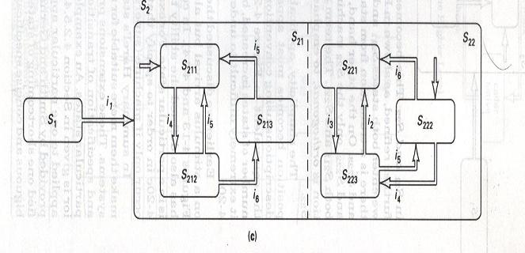
Orthogonal Decomposition using Statecharts

Slide 29
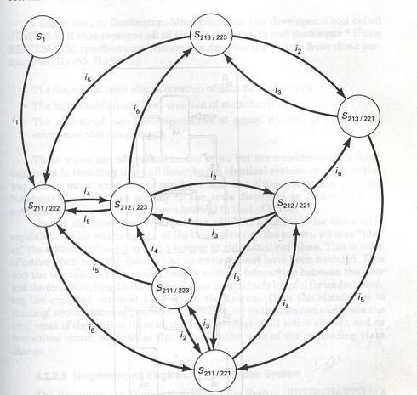
Explosion of States

Slide 30
Statecharts
Statecharts provide natural extensions to FSMs to make them more suitable for specifying external behavior of real-time systems
These extensions provide for hierarchical decomposition of states and specification of transitions dependent on global conditions and being in particular state

Slide 31
Summary
We have introduced the concept of Dynamic modeling
We have covered the statecharting technique in dynamic modeling

Slide 32
References
‘Software Requirements: Objects, Functions, and States’ by Al. Davis, 1993
‘The Unified Modeling Language User Guide’ by G. Booch, J. Rambaugh, & I. Jacobson, Addison-Wesley, 1998
‘The Unified Modeling Language Reference Guide’ by J. Rambaugh, I. Jacobson, & G. Booch, Addison-Wesley, 1998
‘Designing Concurrent, Distributed, and Real-Time Applications with UML’ by H. Gomaa, Addison-Wesley, 2000
Rambaugh et. al.

